Slide 1
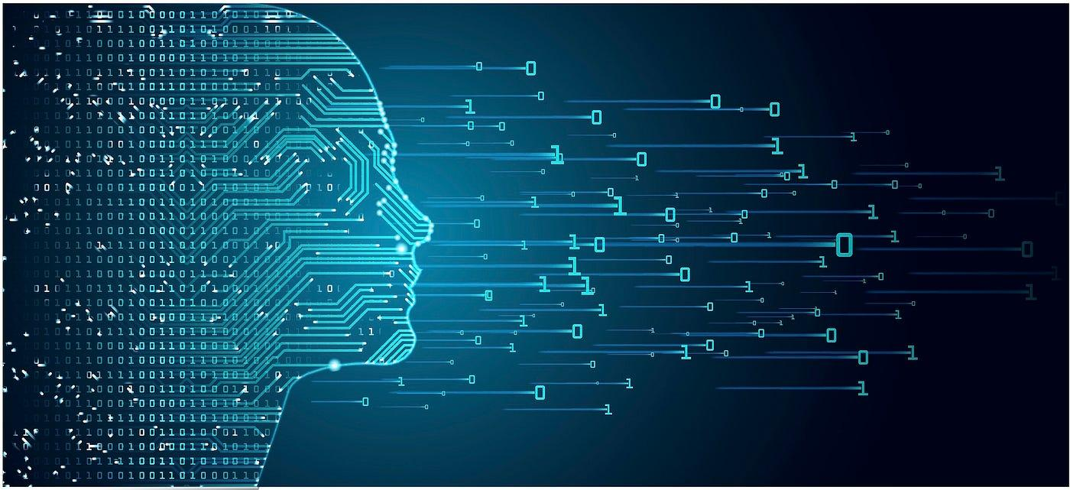
FYP
Regression Algorithms
For Learning
By: Syed Maesum Hussain Zaidi

Slide 2
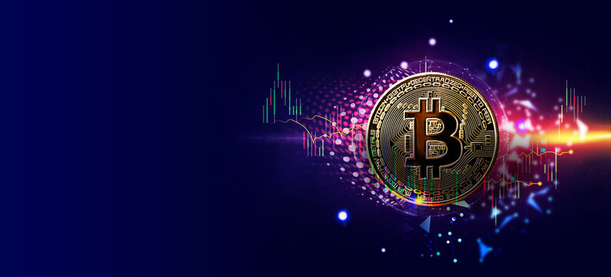
Introduction & Context
Regression Algorithms for Learning & Its Application on Cryptocurrency Market
Main Concepts
Progress Report
Next Steps
Summary

Slide 3

Question
to think
about
during the presentation?

Slide 4

Main Concepts
Regression Algorithms Implementation
Real World Dataset Preprocessing (Bitcoin-US Dollar)
Future Price Prediction
Regression Algorithms Performance Comparison
Different Learning Algorithm Implementation
Overall Comparison between Different Implementations

Slide 5
Progress Report
Report 1: Mathematical Foundations of Regression Algorithms
Report 2: Short Literature Review on works done on related topics
Proof of Concept program on a Synthetic Dataset
Report 3: Connecting the previous reports with the Proof of Concept Program
Program applying Ridge and OLS Regression on BTC-USD dataset to give price prediction for the next day.

Slide 6
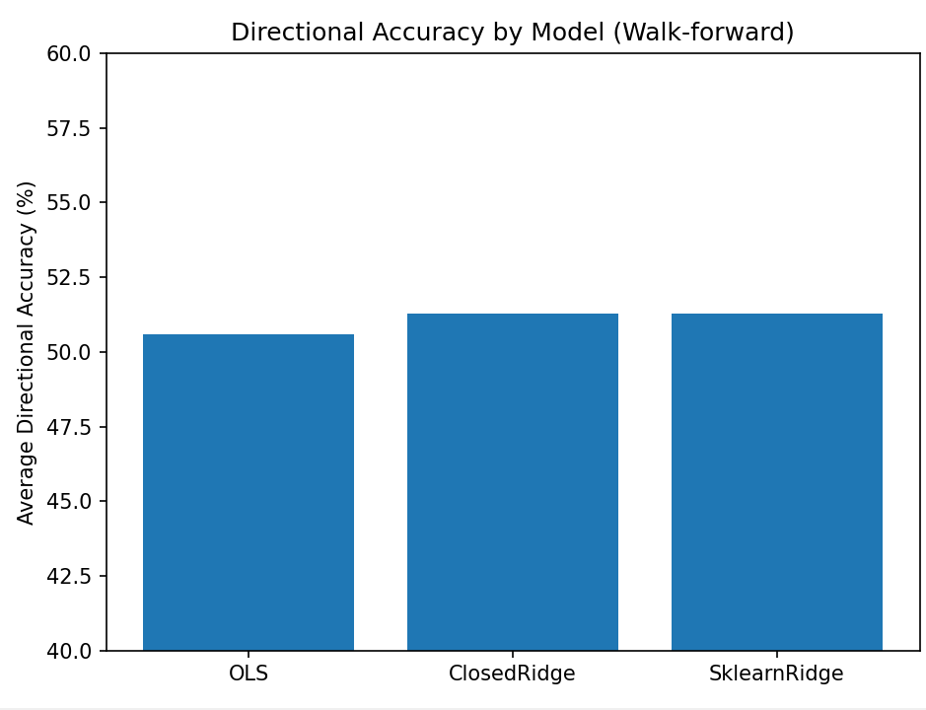
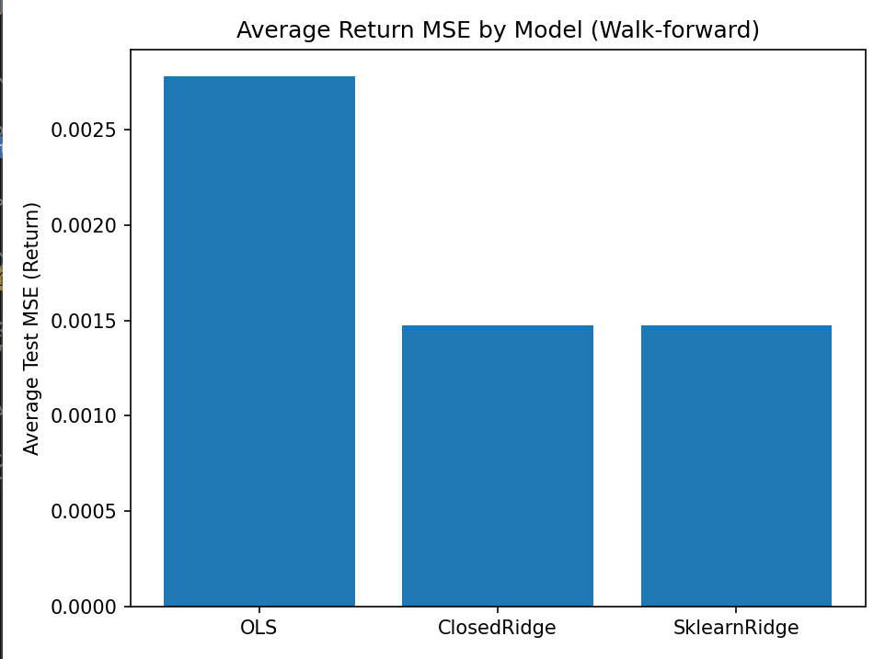

Slide 7

Next Steps
Implement Lasso Regression
Implement Nearest Neighbour Algorithm
Implement Neural Networks Algorithm
Implement a Graphical User Interface
Write Analytical reports based on the Performance comparison from different Learning Algorithms.

Slide 8

Conclusion
Implementing Different Learning Algorithms
For BTC-USD Price Prediction
Current Progress: Ridge and OLS Regression
Next Steps: Lasso Regression, Nearest Neighbour & Neural Networks
Goal: Compare the performances of Different Learning Algorithms

Slide 9
Thank You

